Slide 1
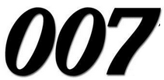
Unit 04: BONDING
IB Topic 3
My Name is Bond. Chemical Bond

Slide 2
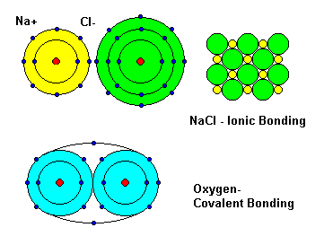
PART 1: Ionic & Covalent Bonding

Slide 3
Chemical Bonds
A chemical bond is an attraction between 2 atoms or ions.
Bonding occurs because it lowers the energy of the system.
Three broad classifications:
Ionic
Covalent
Metallic

Slide 4
Chemical Bonds
Rule of thumb:
Ionic (Metal - Nonmetal)
Covalent (Nonmetal – Nonmetal)
Metallic (Metal – Metal)

Slide 5
To understand why this rule of thumb generally works our, we need to revisit the concept of electronegativity.

Slide 6
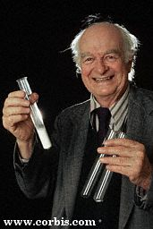
Electronegativity
The electronegativity scale was developed by Linus Pauling.
Electronegativity: the power of an atom in a molecule to attract electrons to itself.

Slide 7
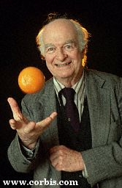
Linus Pauling (1901-1995)
Structure of DNA (almost first)
Nobel Prize in Chemistry 1954
Noble Peace Prize in 1962
Oranges, Vitamin C, and the common cold

Slide 8
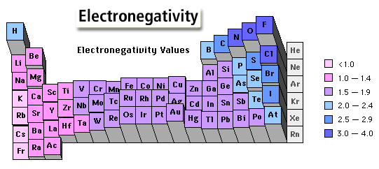
The Pauling Scale of Electronegativity
The Pauling scale was devised in 1932.
Most electronegative element (F) = 4.00 Least electronegative element (Fr) = 0.7 These unitless values are determined by comparing the expected bond energies to the measured bond energies.

Slide 9
Electronegativity
The greater an atom’s electronegativity, the greater its ability to attract electrons.
In a compound, the element with the greater electronegativity will be the more negative species.
The element with lower electronegativity is sometimes referred to as the more “electropositive” element. This will become the more positive species in the bond.

Slide 10
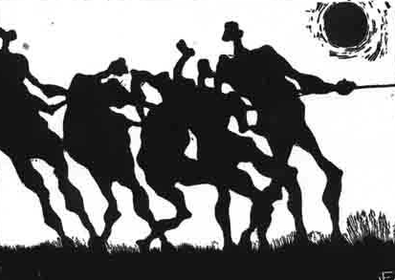
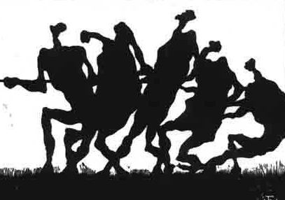
e⁻
A chemical bond is like a tug-of-war between two atoms, each competing for the electron.

Slide 11
Electron tug-of-war analogy
The stronger the team, the higher that team’s electronegativity.
Atoms with higher electronegativity will have greater possession of the electron – that is unequal sharing.

Slide 12
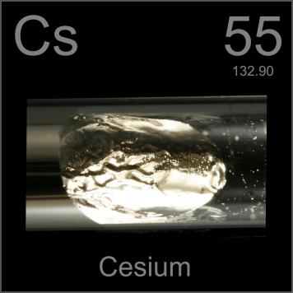
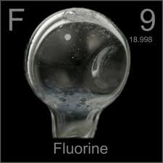
Electron tug-of-war analogy
LOW Electronegativity
HIGH Electronegativity

Slide 13
It’s a tie…
e⁻
equal sharing → covalent bond

Slide 14
The non-metal is pulling harder...
e⁻
So what would unequal sharing be?
polar covalent

Slide 15
The non-metal wins!
e⁻
Transfer of electrons → ionic bond

Slide 16
Ionic & Covalent Bonds: Some Generalizations
Ionic bonds exist between atoms with low electronegativities & those with high electronegativities. In general, between metals and nonmetals.
Polar covalent bonds exist between dissimilar atoms with different electronegativities.
Nonpolar covalent bonds exist between identical nonmetallic atoms or nonmetallic atoms with similar electronegativities.

Slide 17
Atoms react with each other in chemical reactions in a quest to have complete outer electron energy levels like the noble gases.
Ne: 1s²2s²2p⁶
Ar: 1s²2s²2p⁶3s²3p⁶

Slide 18
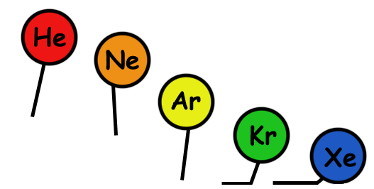
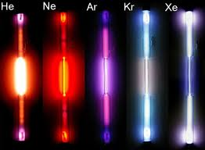
Noble Gases ns² np⁶ Very Stable

Slide 19
Octet Rule
Atoms tend to gain, lose, or share electrons until they are surrounded by eight valence electrons.

Slide 20
Remember: The atom ate (8) until it was full. (LOL)

Slide 21
Duet Rule
Hydrogen and lithium want to have 2 electrons. Recall that the first energy level only holds two electrons.

Slide 22
Ionic Bonding
Different texts report different “cutoff” values, but according to IB, ΔEN > 1.8 for ionic bonds.

Slide 23
Caution!
The idea of a “pure ionic bond” is an oversimplification, even if you consider species such as NaCl.
If we wish to be more accurate, it is safer to refer to compounds as having a “great deal of ionic character.”

Slide 24
Electronegativity
difference
Bond
Type
Zero
Covalent
Covalent character decreases
Ionic character increases
Polar
Covalent
Intermediate
Large
Ionic

Slide 25
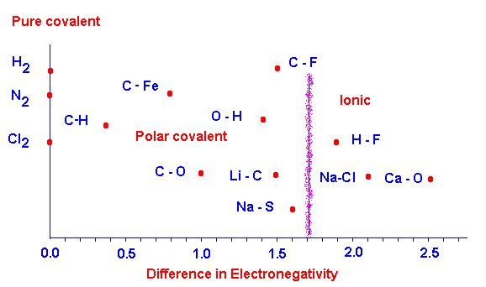
While an electronegativity difference of about 1.8 is the point where a bond may be thought of as ionic, there are a few exceptions to this rule such as HF, in which the electronegativity difference is 1.9, but the molecular properties are decidedly covalent.

Slide 26
Only a rule of of thumb:
Covalent bond = non-metal + non-metal
Ionic bond = metal + non-metal
It's easy to see that this rule is only a rough approximation and works well for compounds of the Group 1 or 2 metals with the halogens. But it doesn't reflect reality when we consider bonds between carbon and most metals. Carbon is certainly a non-metal, but it forms covalent bonds (sometimes highly polar, but covalent none the less) with almost all of the elements on the periodic table

Slide 27
For our purposes in this class, however, we will make some generalizations to simplify our understanding…

Slide 28
The greater the difference in electronegativity between the atoms, the more ionic the bond.

Slide 29
Ionic Bonding
Ionic bonds form between metals on the left of the periodic table and elements in groups 5, 6 & 7 (or polyatomic ions attracted to other ions)
Note: group 4 elements (C and Si) do not form ionic bonds. They tend to form giant molecular structures (network solids) or simple molecules.

Slide 30
Example: NaCl
Sodium (Na) has 11 electrons
1s²2s²2p⁶3s¹
but only one valence electron.
By losing this electron Na becomes Na⁺
1s²2s²2p⁶ or [Ne]
Which has a full outer shell.

Slide 31
Example: NaCl
Chlorine (Cl) has 17 electrons (7 valence electrons)
1s²2s²2p⁶3s²3p⁵
By gaining an electron it becomes...
Cl⁻ 1s²2s²2p⁶3s²3p⁶ or [Ar]
Which also has a filled outer shell.

Slide 32
NaCl
An ionic bond results: electrostatic attractions between two oppositely charged ions.
Na⁺
Cl⁻

Slide 33
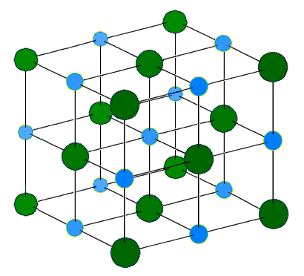
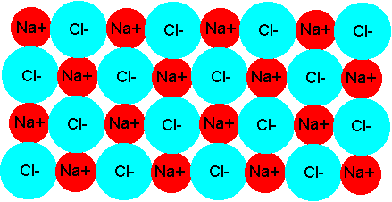
NaCl
These two ions do not exist in isolation. NaCl is simply the formula unit, a representation of the ration of cation:anion in the ionic lattice structure.
2-D
3-D

Slide 34
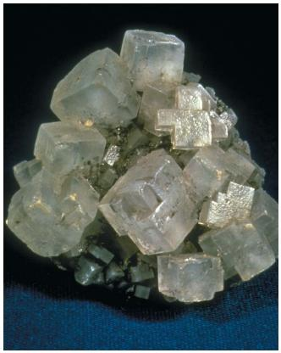
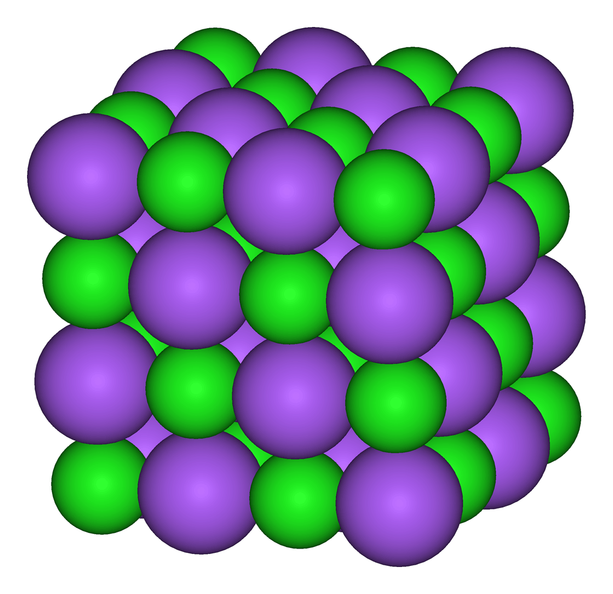
NaCl
In 3-dimentional cubic NaCl, each Na⁺ is surrounded by 6 Cl⁻ ions, and vice versa.

Slide 35
Examples of Ions
Group # | Ex. | Number valence e’s | Number e’s transferred | e’s lost or gained | Charge of ion formed | Type of element
1 | Na | 1 | 1 | lost | +1 | metal
2 | Ca
3 | Al
4 | C
5 | P
6 | O
7 | Br
2
2
lost
+2
metal
3
3
lost
+3
metal
4
-
-
-
nonmetal
5
3
gained
-3
nonmetal
6
2
gained
-2
nonmetal
7
1
gained
-1
nonmetal

Slide 36
Polyatomic Ions: Ions containing more than one element
In ions formed from more than one element the charge is often spread (delocalized) over the whole ion.

Slide 37
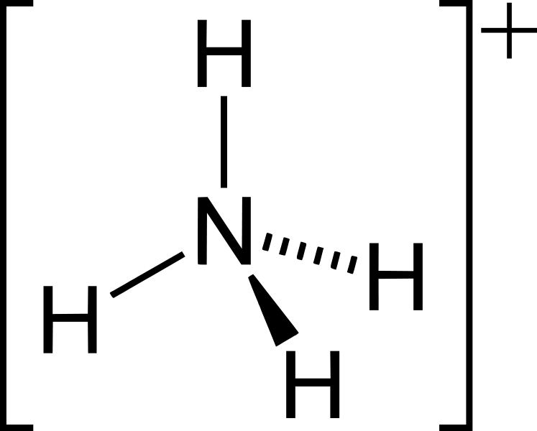
Polyatomic Ions: Ions containing more than one element
Cation example: ammonium, NH₄⁺
All four of the N-H bonds are identical; +1 charge is distributed evenly throughout the ion

Slide 38
Polyatomic anions are sometimes known as acid radicals → formed when an acid loses one or more H⁺ ions.
Anion examples:
Ion name | Formula | From…
Hydroxide |  | Water (H₂O)
Nitrate |  | Nitric acid (HNO₃)
Sulfate |  | Sulfuric acid (H₂SO₄)
Hydrogen sulfate (a.k.a. bisulfate) |  | Sulfuric acid (H₂SO₄)
Carbonate |  | Carbonic acid (H₂CO₃)
Hydrogen carbonate (a.k.a. bicarbonate) |  | Carbonic acid (H₂CO₃)
Ethanoate (a.k.a. acetate) |  | From ethanoic acid (vinegar), or acetic acid (CH₃COOH)
OH⁻
NO₃⁻
SO₄²⁻
HSO₄⁻
CO₃²⁻
HCO₃⁻
CH₃COO⁻

Slide 39
Formulas of Ionic Compounds: Lowest ratio of cation to anion that results in a net charge of zero.
Examples:
Copper (II) sulfate =
Sodium oxide =
Magnesium phosphate =
CuSO₄
Cu²⁺
SO₄²⁻
Na₂O
Na⁺
O²⁻
Mg₃(PO₄)₂
Mg²⁺
PO₄³⁻

Slide 40
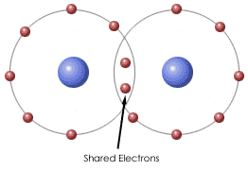
Covalent Bonding
sharing of one or more pairs of electrons to achieve inert gas configuration.

Slide 41
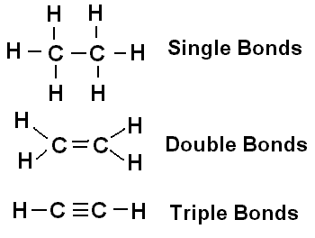
Covalent Bonding
Single covalent bonds: two shared electrons (a single pair)
Multiple covalent bonds:
Double bonds: 4 shared electrons (two pairs)
Triple bonds: 6 shared electrons (three pairs)

Slide 42
Covalent Bonding
Coordinate (dative) covalent bonds: formed when both electrons of the shared pair of electrons originate from the same atom.
Example: carbon monoxide (CO)
C
O
coordinate bond

Slide 43
Lewis Structures: (a.k.a. electron dot structures) show all valence electrons
Examples: All of the following are acceptable ways of representing the diatomic fluorine molecule.

Slide 44
Steps for Writing Lewis Structures:
1. Sum the valence electrons from all the atoms present in the compound. Don’t worry about keeping track of which electrons come from which atom. It is the total number of electrons that is important.
CH₄: 8 total valence electrons

Slide 45
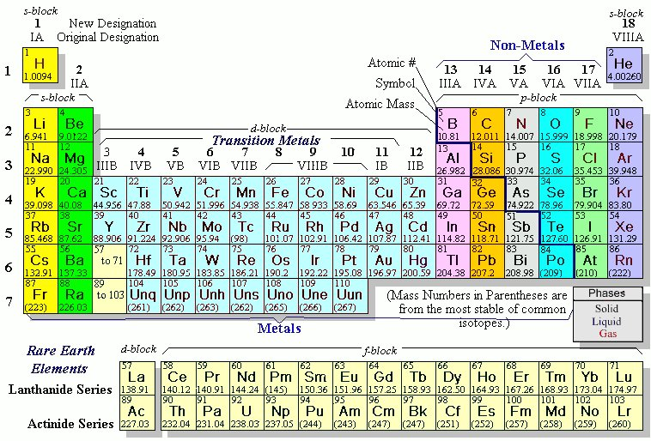
Steps for Writing Lewis Structures:
Draw a skeletal structure. Use a pair of electrons to form a bond between each pair of bound atoms.
Hint #1: The atom with the smallest electronegativity is usually the central atom (H₂O is a notable exception).
COCl₂
Electronegativities
C = 2.5
O = 3.5
Cl = 3.0

Slide 46
Steps for Writing Lewis Structures:
Draw a skeletal structure. Use a pair of electrons to form a bond between each pair of bound atoms.
Hint #2: Polyatomic species are usually clumped and not spread out.
SO₂F₂
O
X
F – S - F
F – O – S – O - F
O

Slide 47
Steps for Writing Lewis Structures:
3. Arrange the remaining electrons to satisfy the duet rule for H and the octet rule for the second-row elements.
CH₃Cl
..
:
:
Cl
H
C
H
H

Slide 48
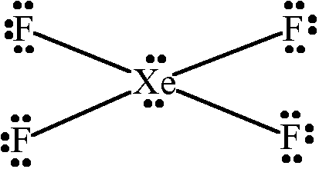
Steps for Writing Lewis Structures:
5. If electrons remain after the octet rule has been satisfied, then place them on the elements having available d orbitals (elements in Period 3 or beyond, often the central atom).

Slide 49
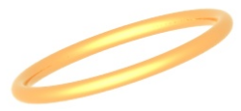
Lewis Structures: Comments about the Octet Rule
The second-row elements C, N, O and F should always obey the octet rule.
F
N
C
O

Slide 50
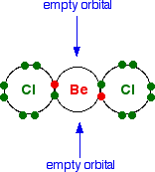
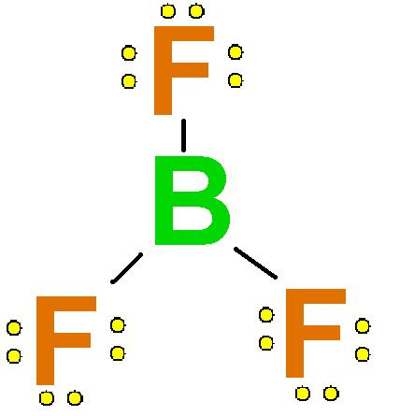
Lewis Structures: Comments about the Octet Rule
The second-row elements B and Be often have fewer than eight electrons around them in their compounds. These electron-deficient compounds are very reactive.

Slide 51
Lewis Structures: Comments about the Octet Rule
The second-row elements never exceed the octet rule, since their valence orbitals (2s and 2p) can accommodate only eight electrons.

Slide 52
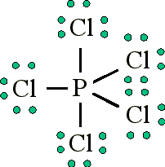
Lewis Structures: Comments about the Octet Rule
Third-row and heavier elements often satisfy the octet rule but can exceed the octet rule by using their empty valence d orbitals.

